Slide 1
Elk Run Phase IV HomeOwners Association
Annual Members Meeting
June 7, 2021
6:00 PM
2021 Plan, Budget, Projections, and Focus

Slide 2
Mission Statement
The primary purpose of a Homeowners’ Association is to maintain and enhance property values and to preserve the character of the Community
The primary role of the Board of Directors is to represent and manage the affairs of the HOA for the benefit of all members

Slide 3
Your HOA’s Board of Directors

Slide 4
Board positions
President
Vice President
Treasurer
Secretary
Building Maintenance
Communications*
Trustee At Large*

Slide 5
2020-2021 Board Accomplishments
Establishment of rolling quarterly budget
Establishment of 5-year budget forecast
Consolidation of Reserve Accounts
Completion of Reserve Study
Selection of new Accounting firm, reducing cost
RFP process and format re-established
Repaint of two buildings plus additional touch up

Slide 6
2020-2021 Board Accomplishments
Resolution of concrete issues
Relaxed parking policy
Revised signage policy to allow greater freedom of speech
Quarterly newsletter
More responsive communications
New owner welcome package
Kinder, gentler HOA posture

Slide 7
Thank you and a “Welcome”?
Current Board
Paul Dorius – President
Don Crim – Vice President
Larry Ballash – Treasurer **
Susanne Barnes – Secretary (& Grounds)
Steve Hicks – Buildings
Keiko Ito - Past President & now Communications
Lee Johnson – At Large
Thank you
Keiko Ito & Susanne Barnes
Larry Ballash
Proposal to retain current Board through 2021 until new slate at next Annual Meeting?
Actively seeking new Board members and desire to establish both tenure and rotation of Board members and positions

Slide 8
Board Member Discussions
A Little History:
Elk Run Phase IV has been in existence for about 28 years.
Board members over this time have tended to serve for long periods of time, generally 10 to 15 years.
The 28 years have been mostly dominated by approximately six Board members, all serving in excess of 10 years each.
Board members have been and are being compensated through credits against their dues, with stipends varying based upon role.
Pro’s & Con’s:
Although this might preserve association knowledge, it can lead to board stagnation or not being receptive to new ideas.
Lengthy Board terms can lead to member burnout.
By adding new members on a regular basis, the Board is kept fresh with new ideas. The Board is also better equipped to stay in tune with the ever-changing demographics of the community.
The Board feels strongly that term limits should be in the range of five years or so.

Slide 9
HOA Management Moving Forward
HOA Membership to date, have been content with electing the same board members year after year.
This needs to change moving forward.
Our homeowner base in Elk Run has a broad range of skill sets that would be useful to the HOA.
It is hoped that all HOA members will consider board service.
We have two choices moving forward.
1. We can continue on with HOA management via a Member board. This will require better participation from a larger number of home owners. Or…
2. We can engage with a professional management company to manage our HOA affairs, overseen by a truly volunteer Member Board. This will be more expensive but could offer more reliable management to our HOA.

Slide 10
HOA Board Member Drive
Solicitation:
Your Elk Run Phase IV Board is now accepting applications for new board members to be seated on or before January 2022.
The Board feels that by doing this it would facilitate for a smooth transition as Board openings become available.
It is the Board’s position that board member positions are not intended to be “life long” career positions, but rather should be available to all HOA residents, on a periodic basis.
Board Member Term Limits Policy.
The Board will be offering a Term Limits policy soon.
The CC&Rs does not limit the period of time Board members serve. However, in order to maintain a representative Board of the HOA membership it is important to give all HOA members the opportunity to serve on the HOA Board.

Slide 11
Building Maintenance and Issues

Slide 12
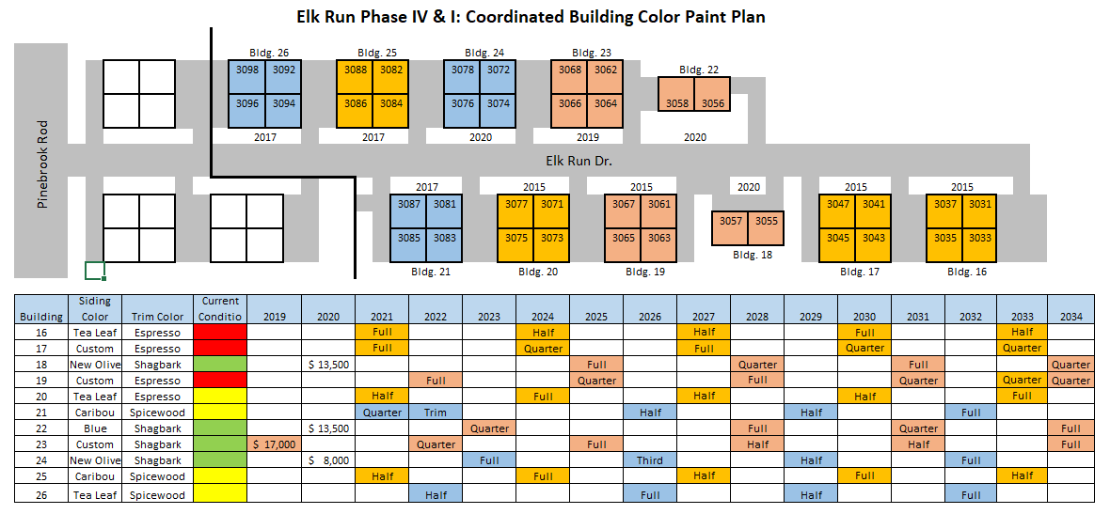
Building Maintenance and Painting Phase and Color Scheme

Slide 13
Anticipated Reserve Spending

Slide 14
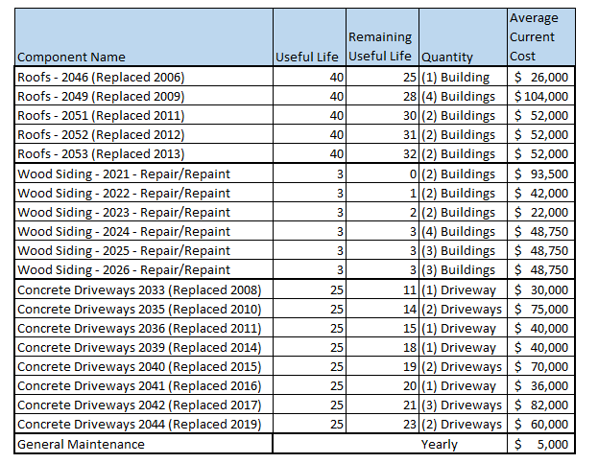
Building Maintenance and Painting Future Capital Expenditures

Slide 15
Fire Suppression
Annual Inspection
Vendor Status
Recall Information

Slide 16
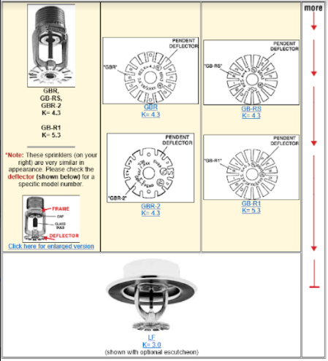
Fire Suppression
1998 Central Fire Sprinkler Recall

Slide 17
Potential Issues
Lumber prices
Labor rates
RFP Results
Full building vs touch up

Slide 18
Grounds
Introduction and explanation of Bolli Landscaping
Beautification Projects
Plans for Snow Removal
Homeowners Input

Slide 19
Communications
New Position:
This is a new Board position created this year to improve HOA communication with all HOA members.
Key Objectives:
To improve communications with all HOA members and to solicit feedback. Direct feedback to the Board.
Create a Quarterly newsletter to all HOA members.
Initiate a new member orientation package to welcome new residents to our community.
Meet one on one with HOA members on a quarterly basis.
Website Maintenance.
Promote New Board Member Recruitment.
Q & A and Recommendations to improve communications

Slide 20
Trustee at Large
New Position:
This is a new Board position created this year to improve HOA communication with all HOA members.
Key Objectives
This position is intended to back-up Board members as necessary. Initial focus was back-up and assistance in management of grounds maintenance and building maintenance projects . It includes assisting in documentation and policy matters.
The HOA Trustee at Large should have a reasonable understanding of computers and the basic software. Be skilled enough to use e-mail, word processing, spreadsheets and a basic understanding of budgets and forecasting. Some experience with contract bidding and negotiations would be very beneficial.
Be willing to learn and understand local, state, and federal regulation policies governing HOA communities. A broad practical / technical understanding of Building / Grounds maintenance projects would be desirable.

Slide 21
HOA Finances and Outlook

Slide 22
Financial Components
Reserve Accounts
State Mandated Reserve Study
3 Year Cycle of Study and then refresh
Operating Cash – Same starting base each year
Operating Budgets
Plans vs Reality
Funding Mechanisms
Dues plus other minor incomes
Assessments
Sale of Assets
Money Management

Slide 23
Reserve Accounts
Concrete – Current Balance $61,063
Roofing – Current Balance $118,850
Buildings – Current Balance $158,755
Total Reserves = $338,668

Slide 24
Reserve Study 2021
Executive Summary – Elk Run at Pinebrook - Phase IV - ID # 12761
Information to complete this Reserve Study was gathered by performing an on-site inspection of the common area elements. In addition, we also obtained information by contacting any vendors and/or contractors that have worked on the property recently, as well as communicating with the property representative (BOD Member and/or Community Manager).
To the best of our knowledge, the conclusions and recommendations of this report are considered reliable and accurate insofar as the information obtained from these sources.
Projected Starting Balance as of 01/01/2021 $288,503
Ideal Reserve Balance as of 01/01/2021 $357,621
Percent Funded as of 01/01/2021 81%
Recommended Reserve Contribution (per month) $7,275
Recommended Special Assessment $0
Elk Run at Pinebrook - Phase IV is a 40-unit Townhome community. The community offers landscaped areas as amenities. Construction on the community was completed in 1992.

Slide 25
Reserve Study 2021 (cont.)
Currently Programmed Projects
Projects programmed to occur this fiscal year (FY2021) include wood siding 2021 partial repair/repaint (Comp# 217). We have programmed an estimated $94,500 in reserve expenditures toward the completion of these projects. (See page 15)
Significant Reserve Projects
The association’s significant reserve projects are wood siding 2024 partial repair/repaint (Comp# 217), driveways 2010 replace (Comp# 403), driveways 2015 replace (Comp# 403), and driveways 2017 replace (Comp# 403). The fiscal significance of these components is approximately 66%, 4%, 4%, and 4% respectively (see page 9). A component’s significance is calculated by dividing its replacement cost by its useful life. In this way, not only is a component’s replacement cost considered but also the frequency of occurrence. These components most significantly contribute to the total monthly reserve contribution. As these components have a high level of fiscal significance the association should properly maintain them to ensure they reach their full useful lives.
Reserve Funding
In comparing the projected starting reserve balance of $288,503 versus the ideal reserve balance of $357,621 we find the association’s reserve fund to be approximately 81% funded. This indicates a strong reserve fund position. In order to continue to strengthen the account fund, we suggest adopting a monthly reserve contribution of $7,275 ($181.88/unit) per month. If the contribution falls below this rate, then the reserve fund may fall into a situation where special assessments, deferred maintenance, and lower property values are likely at some point in the future.
Measures of reserve fund financial strength are as follows:
0% - 30% Funded is considered a “weak” financial position. Associations that fall into this category are more likely to have special assessments and deferred maintenance. Action should be taken to improve the financial strength of the reserve fund.
31% - 69% Funded is considered a “fair” financial position. Associations that fall into this category are less likely to experience special assessments and deferred maintenance than being in a weak financial position. Action should be taken to improve the financial strength of the reserve fund.
70% - 99% Funded is considered a “strong” financial position. Associations that fall into this category are less likely to experience special assessments and deferred maintenance than being in a fair financial position. Action should be taken to improve the financial strength of the reserve fund.
100% Funded is considered an “ideal” financial position. Action should be taken to maintain the financial strength of the reserve fund.

Slide 26
Reserve Study Recommended Funding

Slide 27
Operating Cash Account
Starts each year at $45,000
Current balance is $72,000
All excess funds are distributed into Reserve accounts at year end

Slide 28
P
L
A
N
N
E
D
5-yr
B
U
D
G
E
T
 |  | 2020 |  | 2021 |  | 2022 |  | 2023 |  | 2024 |  | 2025
 |  | Actual |  | 3% YOY |  | 3% YOY |  | 3% YOY |  | 3% YOY |  | 3% YOY
INCOME
Assessments |  | $160,000 |  | $160,000 |  | $160,000 |  | $160,000 |  | $160,000 |  | $160,000
No Proxy Fee |  | $300 |  | $309 |  | $318 |  | $328 |  | $338 |  | $358
Interest |  | $5 |  | $5 |  | $5 |  | $5 |  | $6 |  | $6
Late Fees |  | $632 |  | $651 |  | $670 |  | $691 |  | $711 |  | $755
Reinvestment Fees |  | $350 |  | $361 |  | $371 |  | $382 |  | $394 |  | $418
Collection Fees |  | $25 |  | $26 |  | $27 |  | $27 |  | $28 |  | $30
TOTAL INCOME |  | $161,312 |  | $161,351 |  | $161,392 |  | $161,434 |  | $161,477 |  | $161,567
OPERATING EXPENSES
Fees |  | $171 |  | $176 |  | $181 |  | $187 |  | $192 |  | $204
Copies&Postage |  | $153 |  | $158 |  | $162 |  | $167 |  | $172 |  | $183
Prof.Service |  | $1,120 |  | $1,154 |  | $1,188 |  | $1,224 |  | $1,261 |  | $1,337
Board Services |  | $10,390 |  | $10,702 |  | $11,023 |  | $11,353 |  | $11,694 |  | $12,406
Taxes |  | $172 |  | $177 |  | $182 |  | $188 |  | $194 |  | $205
Gen. Operating |  | $111 |  | $114 |  | $118 |  | $121 |  | $125 |  | $133
Insur. Master Policy |  | $9,703 |  | $9,994 |  | $10,294 |  | $10,603 |  | $10,921 |  | $11,586
Insur. D&O |  | $1,441 |  | $1,484 |  | $1,529 |  | $1,575 |  | $1,622 |  | $1,721
Legal |  | $1,485 |  | $1,530 |  | $1,575 |  | $1,623 |  | $1,671 |  | $1,773
Accounting |  | $5,300 |  | $5,459 |  | $5,623 |  | $5,791 |  | $5,965 |  | $6,328
Maint. & Repairs |  | $784 |  | $808 |  | $832 |  | $857 |  | $882 |  | $936
Fire Sprinklers |  | $2,901 |  | $2,988 |  | $3,078 |  | $3,170 |  | $3,265 |  | $3,464
Landscaping Cont. |  | $34,150 |  | $35,175 |  | $36,230 |  | $37,317 |  | $38,436 |  | $40,777
Landscaping Sprinklers |  | $1,133 |  | $1,167 |  | $1,202 |  | $1,238 |  | $1,275 |  | $1,353
Tree Spray |  | $849 |  | $874 |  | $901 |  | $928 |  | $956 |  | $1,014
Landscaping Fert. |  | $1,107 |  | $1,140 |  | $1,174 |  | $1,210 |  | $1,246 |  | $1,322
Snow Removal |  | $4,680 |  | $4,820 |  | $4,965 |  | $5,114 |  | $5,267 |  | $5,588
Electricity |  | $154 |  | $159 |  | $163 |  | $168 |  | $173 |  | $184
Water |  | $6,086 |  | $6,269 |  | $6,457 |  | $6,650 |  | $6,850 |  | $7,267
TOTAL EXPENSE |  | $81,890 |  | $84,347 |  | $86,877 |  | $89,483 |  | $92,168 |  | $97,781
NET OPERATING INCOME |  | $79,422 |  | $77,005 |  | $74,515 |  | $71,950 |  | $69,309 |  | $63,786
 |  |  |  | need 10K |  | need 15K |  | need 20K |  | need 23K |  | need 32K

Slide 29
Reserve Study and Planned Budget – Anticipated Deficit
March 8th and March 11th emails sent were based upon Planned Budgets and anticipated deficit to Reserves of $100K
Suggested dues increase of 12.5% was a proactive means to resolve the Study recommendations within the Planned Budget
This could not anticipate any budgetary surprises above the 3% inflation rate calculated

Slide 30
2021 Budgetary Surprises
Grounds contractor GMS was purchased by Eshenfelder with notice to Elk Run in March 2021 w/ total change in methodology and proposed 34% increase in costs
RFP replaced Eshenfelder with Bolli, but even so increase in costs is real and permanent
Insurance re-evaluation to provide full coverage by increasing limits to today’s replacement costs brings increase in premium of 35%
Likely, more surprises yet to come

Slide 31
Key Take-aways from Finances
Forecasts are not set in stone
Costs have been and are rising
New expense has not been matched with new income
Reserves are strong but not perfect
The Study is a recommendation, not a specific obligation
Action is warranted and necessary
Either Dues need to be raised starting immediately, or a major Assessment is going to be needed at some point in the near future

Slide 32
w “Real” Costs
R
E
V
I
S
E
D
5-yr
B
U
D
G
E
T
 |  | 2020 |  | 2021 |  | 2022 |  | 2023 |  | 2024 |  | 2025
 |  | Actual |  | 3% YOY |  | 3% YOY |  | 3% YOY |  | 3% YOY |  | 3% YOY
INCOME
Assessments |  | $160,000 |  | $160,000 |  | $160,000 |  | $160,000 |  | $160,000 |  | $160,000
No Proxy Fee |  | $300 |  | $309 |  | $318 |  | $328 |  | $338 |  | $358
Interest |  | $5 |  | $5 |  | $5 |  | $5 |  | $6 |  | $6
Late Fees |  | $632 |  | $651 |  | $670 |  | $691 |  | $711 |  | $755
Reinvestment Fees |  | $350 |  | $361 |  | $371 |  | $382 |  | $394 |  | $418
Collection Fees |  | $25 |  | $26 |  | $27 |  | $27 |  | $28 |  | $30
TOTAL INCOME |  | $161,312 |  | $161,351 |  | $161,392 |  | $161,434 |  | $161,477 |  | $161,567
OPERATING EXPENSES
Fees |  | $171 |  | $176 |  | $181 |  | $187 |  | $192 |  | $204
Copies&Postage |  | $153 |  | $158 |  | $162 |  | $167 |  | $172 |  | $183
Prof.Service |  | $1,120 |  | $1,154 |  | $1,188 |  | $1,224 |  | $1,261 |  | $1,337
Board Services |  | $10,390 |  | $10,702 |  | $11,023 |  | $11,353 |  | $11,694 |  | $12,406
Taxes |  | $172 |  | $177 |  | $182 |  | $188 |  | $194 |  | $205
Gen. Operating |  | $111 |  | $114 |  | $118 |  | $121 |  | $125 |  | $133
Insur. Master Policy |  | $9,703 |  | $15,587 |  | $16,536 |  | $17,032 |  | $17,543 |  | $18,070
Insur. D&O |  | $1,441 |  | $0 |  | $0 |  | $0 |  | $0 |  | $0
Legal |  | $1,485 |  | $1,530 |  | $1,575 |  | $1,623 |  | $1,671 |  | $1,773
Accounting |  | $5,300 |  | $5,459 |  | $5,623 |  | $5,791 |  | $5,965 |  | $6,328
Maint. & Repairs |  | $784 |  | $808 |  | $832 |  | $857 |  | $882 |  | $936
Fire Sprinklers |  | $2,901 |  | $2,988 |  | $3,078 |  | $3,170 |  | $3,265 |  | $3,464
Landscaping Cont. |  | $34,150 |  | $55,000 |  | $58,350 |  | $58,350 |  | $60,100 |  | $61,903
Landscaping Sprinklers |  | $1,133 |  | $1,167 |  | $1,202 |  | $1,238 |  | $1,275 |  | $1,353
Tree Spray |  | $849 |  | $874 |  | $901 |  | $928 |  | $956 |  | $1,014
Landscaping Fert. |  | $1,107 |  | $1,140 |  | $1,174 |  | $1,210 |  | $1,246 |  | $1,322
Snow Removal |  | $4,680 |  | $4,820 |  | $4,965 |  | $5,114 |  | $5,267 |  | $5,588
Electricity |  | $154 |  | $159 |  | $163 |  | $168 |  | $173 |  | $184
Water |  | $6,086 |  | $6,269 |  | $6,457 |  | $6,650 |  | $6,850 |  | $7,267
TOTAL EXPENSE |  | $81,890 |  | $108,281 |  | $113,710 |  | $115,371 |  | $118,832 |  | $123,670
NET OPERATING INCOME |  | $79,422 |  | $53,070 |  | $47,681 |  | $46,062 |  | $42,644 |  | $37,896
 |  |  |  | need 34K |  | need 42K |  | need 46K |  | need 50K |  | need 58K | Total = 230K

Slide 33
So, What Do We Do?

Slide 34
Possible / Proposed Action
#1 12.5% Dues Increase ($125 per Qtr) starting 2nd half 2021 + eventual assessment of approx. $5000 per owner
#2 15% Dues Increase ($150 per Qtr) starting 2nd half 2021 + eventual assessment of approx. $3500 per owner
#3 25% Dues Increase ($250 per Qtr) starting 2nd half of 2021 with no anticipated assessment
#4 Straight forward assessment of approx. $6500 per owner (timing to be determined)

Slide 35
Budget Forecast 15% dues increase, real costs+3% inflation
 |  | 2020 |  | 2021 |  | 2022 |  | 2023 |  | 2024 |  | 2025
 |  | Actual |  | 3% YOY |  | 3% YOY |  | 3% YOY |  | 3% YOY |  | 3% YOY
INCOME
Assessments |  | $160,000 |  | $172,000 |  | $184,000 |  | $184,000 |  | $184,000 |  | $184,000
No Proxy Fee |  | $300 |  | $309 |  | $318 |  | $328 |  | $338 |  | $358
Interest |  | $5 |  | $5 |  | $5 |  | $5 |  | $6 |  | $6
Late Fees |  | $632 |  | $651 |  | $670 |  | $691 |  | $711 |  | $755
Reinvestment Fees |  | $350 |  | $361 |  | $371 |  | $382 |  | $394 |  | $418
Collection Fees |  | $25 |  | $26 |  | $27 |  | $27 |  | $28 |  | $30
TOTAL INCOME |  | $161,312 |  | $173,351 |  | $185,392 |  | $185,434 |  | $185,477 |  | $185,567
OPERATING EXPENSES
Fees |  | $171 |  | $176 |  | $181 |  | $187 |  | $192 |  | $204
Copies&Postage |  | $153 |  | $158 |  | $162 |  | $167 |  | $172 |  | $183
Prof.Service |  | $1,120 |  | $1,154 |  | $1,188 |  | $1,224 |  | $1,261 |  | $1,337
Board Services |  | $10,390 |  | $10,702 |  | $11,023 |  | $11,353 |  | $11,694 |  | $12,406
Taxes |  | $172 |  | $177 |  | $182 |  | $188 |  | $194 |  | $205
Gen. Operating |  | $111 |  | $114 |  | $118 |  | $121 |  | $125 |  | $133
Insur. Master Policy |  | $9,703 |  | $15,925 |  | $16,403 |  | $16,895 |  | $17,402 |  | $17,924
Insur. D&O |  | $1,441 |  | $1,484 |  | $1,529 |  | $1,575 |  | $1,622 |  | $1,721
Legal |  | $1,485 |  | $1,530 |  | $1,575 |  | $1,623 |  | $1,671 |  | $1,773
Accounting |  | $5,300 |  | $5,459 |  | $5,623 |  | $5,791 |  | $5,965 |  | $6,328
Maint. & Repairs |  | $784 |  | $808 |  | $832 |  | $857 |  | $882 |  | $936
Fire Sprinklers |  | $2,901 |  | $2,988 |  | $3,078 |  | $3,170 |  | $3,265 |  | $3,464
Landscaping Cont. |  | $34,150 |  | $55,000 |  | $58,350 |  | $58,350 |  | $60,100 |  | $61,903
Landscaping Sprinklers |  | $1,133 |  | $1,167 |  | $1,202 |  | $1,238 |  | $1,275 |  | $1,353
Tree Spray |  | $849 |  | $874 |  | $901 |  | $928 |  | $956 |  | $1,014
Landscaping Fert. |  | $1,107 |  | $1,140 |  | $1,174 |  | $1,210 |  | $1,246 |  | $1,322
Snow Removal |  | $4,680 |  | $4,820 |  | $4,965 |  | $5,114 |  | $5,267 |  | $5,588
Electricity |  | $154 |  | $159 |  | $163 |  | $168 |  | $173 |  | $184
Water |  | $6,086 |  | $6,269 |  | $6,457 |  | $6,650 |  | $6,850 |  | $7,267
TOTAL EXPENSE |  | $81,890 |  | $110,103 |  | $115,106 |  | $116,808 |  | $120,313 |  | $125,245
NET OPERATING INCOME |  | $79,422 |  | $63,248 |  | $70,286 |  | $68,625 |  | $65,164 |  | $60,322
 |  |  |  | need 24K |  | need 19K |  | need 24K |  | need 30K |  | need 38K
 |  |  |  |  |  |  |  |  |  |  |  |  | total 135K
 |  |  |  |  |  |  |  |  |  |  |  |  | $3.5 K per unit

Slide 36
Other subjects and interests
Other Subjects to discuss
Parking
Signage
Other Topics?

Slide 37
Summer Parking
A majority vote is required to make the trial policy permanent
Proposed as an Amendment for the Elk Run Phase IV CCR’s, be it adopted that this policy be adopted to expand the parking rules as follows:
The rules for Summer Parking, roughly encompassing the period of May 1 through November 1, are as follows:
1. Residents/Unit Owners occupying common driveways are referred to in this proposal as “Resident Community”. Owners with tenants will have only one vote that will be submitted by the owner of the unit.
2. The Board encourages residents to continue to park cars in their garages in the summer but for situations where additional overnight (summer only) parking is needed, each “Resident Community” can determine what possibilities exist on their own common driveways for extra cars and visitors.
3. The Board requires each “Resident Community” work together to configure parking in such a way that additional cars do not inconvenience the units sharing the driveway.
4. The Board reiterates that these spaces are for vehicles only and not for commercial vehicles, non-operating vehicles or equipment other than cars. They are for residents or their guests and in no way should block or inconvenience other residents sharing the driveway.
5. All residents of the “Resident Community” must be in agreement as to placement of extra cars. If it is unable to come to agreement and would like the Board to facilitate an agreement the Board will offer a solution upon request. With an impasse, the proposal shall become void for that “Resident Community” and the historic limitations on parking will apply.

Slide 38
Signage
A majority vote is required to make a change to the HOA signage policy permanent
Therefore: be it adopted that the signage policy of the Elk Run Phase IV HOA CC&Rs be modified to allow the following:
1. Homeowners are permitted to display signage in their homeowner space for pre-approved days listed.
2. Homeowners are permitted to display signage for a period of time of 60 days prior to the election for state, local and national elections. For annual holidays, signage may be displayed for a 30 day period prior to the holiday. All signage must be taken down no more than seven days after the event.
3. Signage is limited to no more than two signs per unit and cannot be larger than 30” X 40” in size and cannot be hung from the homeowner’s unit and cannot extend no higher than 18” from the bottom of the sign above the ground or concrete sidewalk.
4. Signage that is derogatory and offensive, as determined by the HOA board, is not permitted. The HOA, at their sole discretion, has the right to disapprove any such signage.
Pre-approved occasions:
Local, State, and National elections
Memorial Day
Presidents Day
The fourth of July
Labor Day

Slide 39
Vote NOW
Should we enact change to make the trial summer parking accommodation permanent?
Should we enact change to make the proposed signage policy effective?
How should we address the Reserve / Budgetary Shortfall : Option #1, #2, #3, or #4?

