Slide 1
Elk Run Phase IV
HomeOwners Association
Annual Members Meeting
June15, 2022
7:00 PM
2022 Plan, Budget, Projections, and Focus

Slide 2
AGENDA
General Issues
  Mission
  Board
Finances
Building Maintenance and Issues
  Paint and Carpentry schedule
  Fire Suppression
Grounds
  Landscaping and Snow Removal
  Community Garden
A Cautionary Tale
Other subjects and interests
Open discussion

Slide 3
Mission Statement
The primary purpose of a Homeowners’ Association is to maintain and enhance property values and to preserve the character of the Community
The primary role of the Board of Directors is to represent and manage the affairs of the HOA for the benefit of all members

Slide 4
The HOA’s Board of Directors

Slide 5
“Welcome” and a Thank you
  Current Board Members
    Paul Dorius - President
    Keiko Ito – Secretary /Communications
    Adam Noelck – Finance
    Susanne Barnes – Grounds
    Steve Hicks – Buildings
    Jack Creed – At Large, PMA
    Todd Landis – At Large ***
  Thank you
  Don Crim – Resigned as Vice President
  Actively seeking new Board members and desire to establish both tenure and rotation of Board members and positions
Welcome
Welcome
Welcome

Slide 6
2020-2021 Board Accomplishments
Continuing 5-year budget process
  Anticipated budget impacts of cost increases
    Ended year under budget (revised 7-2021)
    Bolstered Reserves closer to Study requirements
    Thanks to Members for supporting Dues increase
Updated HOA Insurance policy
Published Quarterly newsletters
Continued New Owner welcome package
More responsive communications

Slide 7
Discussion on Elections
  We need to have a discussion about our Elections, our candidates, our process
  But…… Later in the meeting.

Slide 8
HOA Finances and Outlook

Slide 9
Financial Components
Reserve Accounts
State Mandated Reserve Study
3 Year Cycle of Study and then refresh
Operating Cash – Same starting base each year
Operating Budgets
Plans vs Reality
Funding Mechanisms
Dues plus other minor incomes
Assessments
Sale of Assets

Slide 10
Elk Run at Pinebrook - Phase IV
Level 2 Reserve Study
Report Period – 01/01/2021 – 12/31/2021
Client Reference Number 12761
  Property Type Townhouse
  Number of Units 40
  Fiscal Year End 12/31
Type of Study Update w/Site Visit
Date of Property Inspection 11/6/2020
Prepared By Dale Gifford
Analysis Method Cash Flow
Funding Goal Full Funding
Report prepared on – Monday, December 14, 2021
  TEL: (888) 356-3783 | Fax: (866) 279-9662
  WWW.COMPLEXSOLUTIONSLTD.Com
Draft

Slide 11
Reserve Study Recommended Funding

Slide 12
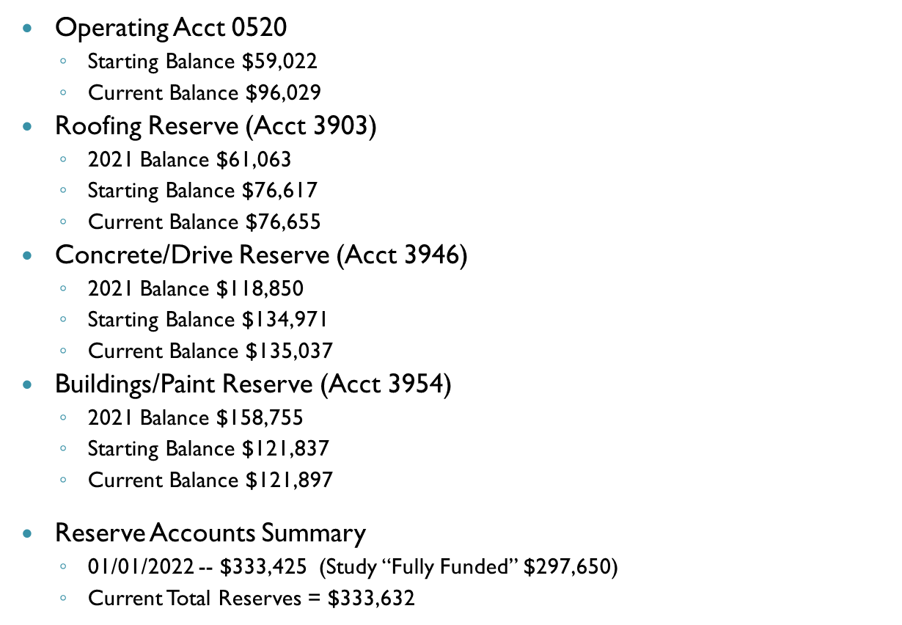
Reserve Accounts

Slide 13
Operating Cash Account
Starts each year at $45,000
All excess funds are distributed into Reserve accounts
Current balance is $94,072

Slide 14
2022 Planned 5 Year Budget

Slide 15
Key Take-aways from Finances
Dues Increase allowed appropriate handling of increased expenses
Forecasts are not set in stone
Costs continue to rise, but are being managed
Reserves are stronger and in great shape
Vigilance will continue to be warranted and necessary
Thank you for helping all of us by agreeing to the dues increase in 2021

Slide 16

Building Maintenance and Issues

Slide 17
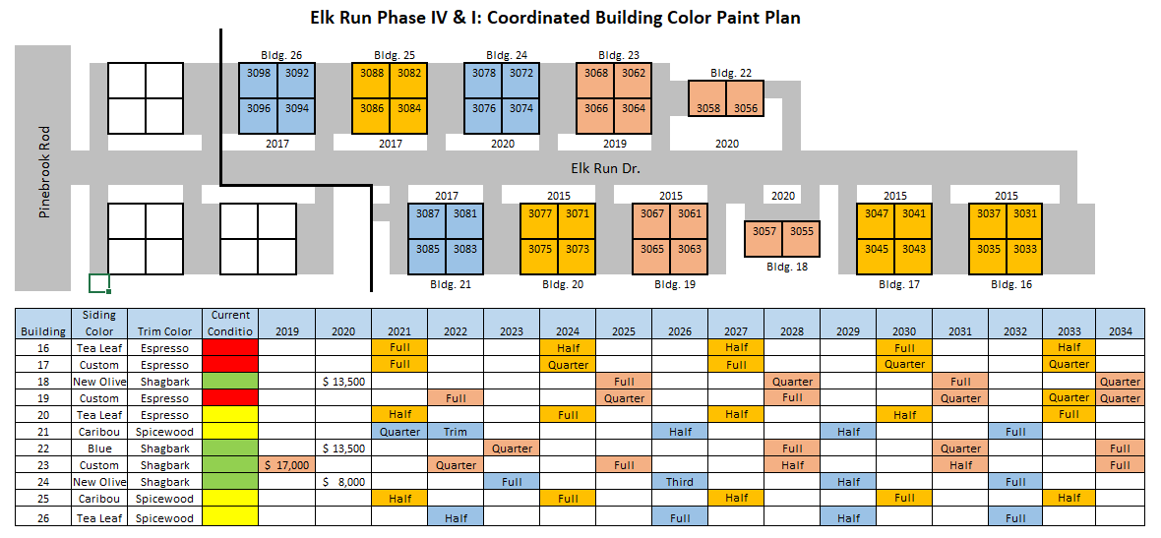
Building Maintenance and Painting
Phase and Color Scheme

Slide 18
Building Maintenance and Painting
Cost Schedule

Slide 19
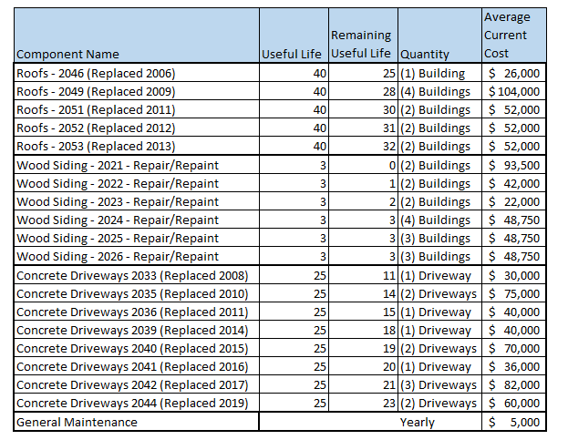
Building Maintenance and Painting
Future Capital Expenditures

Slide 20
Potential Issues
Lumber prices
Labor rates and availability
Weather
Inflation

Slide 21
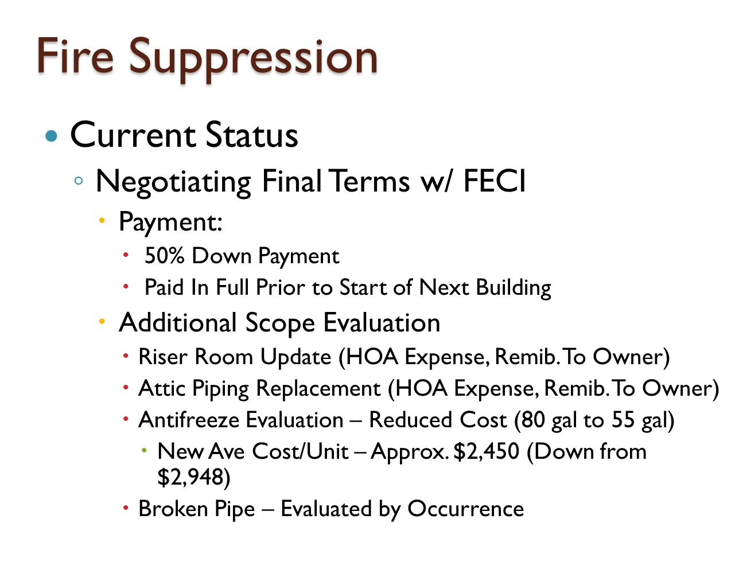

Slide 22
Fire Suppression
Timing
  Expected Release from FECI to Begin Scheduling Work on 6/20/22
  Building Point of Contact
    4 Buildings Provided POC
    5 Buildings Need POC
Homeowner Requirements
  1.5 Days Expected Duration / Unit (1 Week/Bldg)
  Access to Unit
  Moving/Protection of Furniture Below Sprinkler Heads
  Repair of Drywall as Required
  Questions?

Slide 23


Landscaping and Snow Removal
Bolli Landscaping
Beautification Projects
      Mulching
      Tree trimming
Plans for Snow Removal
      Eschenfelder
Homeowners Input

Slide 24
Community Garden
Update on plans:
Committee members
Timeframes
Costs
Location
Obligations
Opportunity

Slide 25
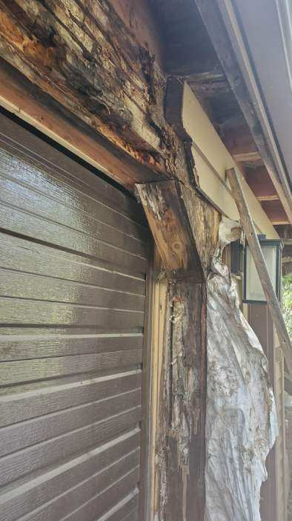
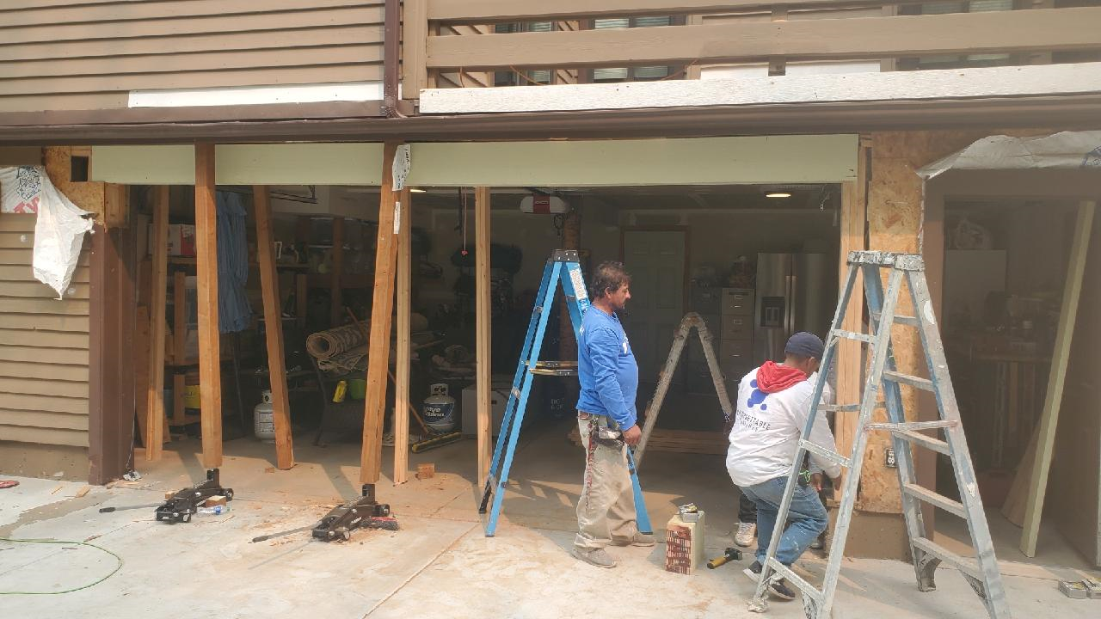
Cautionary Tale
Dry rot due to leaks from over-garage deck
Penetration of the water/ice barrier at posts
Signs of leaks and rot were subtle
Damage was done over time, gradually
Insurance usually does not cover gradual rot
Overall cost was approximately $1500
If you have seen evidence of leaks, check!

Slide 26
HOA Policies and trials
  Does the HOA adopt -
    Signage Policy?
    Parking Policy?

Slide 27
Elk Run Phase IV Signage Proposal and Vote
The CC&Rs for our association reads as follows: Paragraph 6.2.7 of the CC&Rs states: “Without the prior written consent of the HOA or designee, a Unit Owner shall not permit any sign of any kind to be displayed to the public view from his unit except for a small sign, conspicuously placed, stating that the unit is for sale.”
The HOA board believes that there are certain incidences where it is appropriate to allow homeowners the opportunity to display signage for certain reasons. These occasions could be such occasions as Local, State, or national elections, holidays such as, Fourth of July, Memorial Day, Labor Day, and Presidents Day.
As a result, the HOA is proposing Pre-authorization for these holidays, with certain limitation.
The Proposal:
1. Homeowners are permitted to display signage in their homeowner space for the pre-approved days as listed below.
2. Homeowners are permitted to display signage for a period of time of 60 days prior to the election for state, local and national elections. For annual holidays, signage may be displayed for a 30 day period prior to the holiday. All signage must be taken down no more than seven days after the event.
3. Signage is limited to no more than two signs per unit and cannot be larger than 30” X 40” in size and cannot be hung from the homeowners unit and cannot extend no higher than 18” from the bottom of the sign above the ground or concrete sidewalk.
Signage that is derogatory and offensive, as determined by the HOA board, is not permitted. The HOA, at their sole discretion, has the right to disapprove any such signage.
Pre-approved occasions:
Local, State, and National elections
Memorial Day
Presidents Day
The fourth of July
Labor Day

Slide 28
Modified Winter Parking Rules Proposal and Vote
1. Residents/Unit Owners occupying common driveways are referred to in this proposal as “Resident Community.” Owners with tenants will have only one vote that will be submitted by the owner of the unit. Please understand owners of rental units will be responsible for the actions of their tenants.
2. The Board encourages residents to continue to park cars in their garages in the winter but for situations where additional overnight parking is needed, each “Resident Community” can determine what possibilities exist on their own common driveways for extra cars and visitors.
3. Any resident that disrupts the snow removal process for any reason MUST remove any snow promptly (within four hours). If the snow is not removed promptly, and a complaint is launched, the board reserves the right to take action regarding this issue including calling out additional efforts by our contracted snow removal contractors, at homeowner expense, to remedy failure to comply. Furthermore, if HOA action is required, this could result in fines and charges, under existing rules, to the homeowner.
4. The Board requires each “Resident Community” work together to configure parking in such a way that additional cars do not inconvenience the units sharing the driveway community. All members of a “Resident Community” MUST agree with this policy for it to be in effect for any given “Resident Community.”
5. Termination: This policy can be terminated at any time with written notice to the HOA board from one or more members of any “Resident Community.” The parking policy for that community will then revert back to the long-standing winter parking rules

Slide 29
Modified Winter Parking Rules (continued)
.
6. The Board reiterates that these spaces are for vehicles only and not for commercial vehicles, non-operating vehicles or equipment other than cars. They are for residents or their guests and in no way should block or inconvenience other residents sharing the driveway. The board would highly recommend residents utilize “Overflow” parking spaces only to minimize damage to vehicles due to the snow removal process. The snow removal company is not responsible / liable for any damage to vehicles parked in snow covered driveways.
7. Parking vehicles during the snow season is “Park at Your Own Risk.” The HOA takes NO responsibility for damages to vehicles resulting under this policy. Adopting this policy is solely at the discretion of the occupants of individual “Resident Communities.”
8. All residents of the “Resident Community” must be in agreement as to placement of extra cars. If for any reason the “Resident Community” is unable to come to agreement, the proposal shall become void for that “Resident Community” and existing winter parking rules would be in effect.
9. The attached application must be received and approved by the HOA prior to implementation of this proposal.

Slide 30
Modified Winter Parking Rules Form
This form is required for each “Resident Community” that would like to participate in the modified winter
parking proposal. It must be signed by all residents of the “Residents Community.”
This form MUST be on file with the HOA for this proposal to be in effect.
1. Unit Address _____________________________________________________________.
Unit Owners Name. ________________________________. ________________
Signature Date ______________________________ ___________________
2. Unit Address _____________________________________________________________.
Unit Owners Name. ________________________________. ________________
Signature Date ______________________________ ___________________
3. Unit Address ______________________________________________________________.
Unit Owners Name. ________________________________. _________________
Signature Date ______________________________ ___________________
4. Unit Address _______________________________________________________________.
Unit Owners Name. ________________________________. ________________
Signature Date ______________________________ ___________________
Does each member of the “Resident Community” have access to a snow removal device? Yes / No.
By signing above you acknowledge that you have read and understand the proposal and agree to the rules
and terms set forth in this agreement.

Slide 31
NOW, Back to
The HOA’s Board of Directors

Slide 32
Board Composition and Initiatives
All Members of the Community should be willing to serve on the Board
Board positions have been outlined and job descriptions posted on our website
Skill replacement is a critical, ongoing need
Board members are compensated based upon position via a credit against dues

Slide 33
Discussion on Elections
  Do we need term limits
  Do we want a minimum number of votes for someone to be on the Board
  Do we allow mail-in, voice, or remote votes
  If we cannot get new candidates, what do we do? Can we hold-over Board members or positions? (This is defacto right now)
  Etc.

Slide 34
Other subjects and interests
Other Subjects for discussion
  How do we want to do registration for the Annual Meeting
  What are the Proxy and Voting rules and guidelines
  Do we allow for Zoom attendance and Zoom-based voting
  Do we need more Internet or Zoom – based communications / meetings?
Other Subjects?

Slide 35
THANK YOU FOR COMING

