Slide 1
Elk Run Phase IV Homeowners’ Association
Annual Members Meeting
June 28, 2023
6:30 PM Light Refreshments
7:00 PM Meeting
2023 Plan, Budget, Projections, and Focus

Slide 2
AGENDA
General Issues
Mission
Board
Finances
Reserve Changes made
Budgeting
Building Maintenance and Issues
Paint and Carpentry schedule
Fire Suppression
Grounds
Landscaping and Snow Removal
Community Garden
Member Vote on Board Members
Open discussion

Slide 3
Mission Statement
The primary purpose of a Homeowners’ Association is to maintain and enhance property values and to preserve the character of the Community
The primary role of the Board of Directors is to represent and manage the affairs of the HOA for the benefit of all members

Slide 4
The HOA’s Board of Directors

Slide 5
Board Composition and Initiatives
All Members of the Community should be willing to serve on the Board
Board positions have been outlined and job descriptions posted on our website
Skill replacement is a critical, ongoing need
Board members are compensated for their service via a credit against dues

Slide 6
“Welcome” and a Thank you
Current Board Members
Paul Dorius - President
Keiko Ito – Secretary /Communications
Adam Noelck – Finance
Thank you
Susanne Barnes – Grounds
Steve Hicks – Buildings
Jack Creed – Website
Todd Landis – Snow removal
Actively seeking new Board members and desire to establish both tenure and rotation of Board members and positions
More on this in a minute!

Slide 7
2022-2023 Board Accomplishments
Survived the 2022-2023 Winter
Fire Suppression Systems
Most building systems have been updated with new and conforming Sprinkler heads
Most attic piping has been replaced with new, per code materials
Plan is in place to finish the rest and renew certifications with Summit County Fire Marshall and Gorgoza Water
Website organized and consolidate
Simplified look and feel
Eliminated redundancies and conflicts

Slide 8
Discussion on Elections
There some CC&R requirements.
But…
Do we need term limits?
Do we want a minimum number of votes for someone to be on the Board?
Do we allow mail-in, voice, or remote votes?
If we cannot get new candidates, what do we do? Can we hold-over Board members or positions? (This is defacto right now)?
Etc.

Slide 9
Candidates for our 2023-24 Board
Current members
Paul Dorius
Keiko Ito
Adam Noelck
These members have expressed a willingness to continue for another year.
Prospective members
Tina Coombs
Antonia Bishop
These neighbors have expressed a willingness to join the Board. Additionally, both have attended a couple of Board meetings and participated as members.
And now, a Vote!

Slide 10
HOA Finances and Outlook

Slide 11
Financial Components
Reserve Accounts
State Mandated Reserve Study
3 Year Cycle of Study and then refresh
Operating Cash – Same starting base each year
Operating Budgets
Plans vs Reality
Funding Mechanisms
Dues plus other minor incomes
Assessments
Sale of Assets

Slide 12
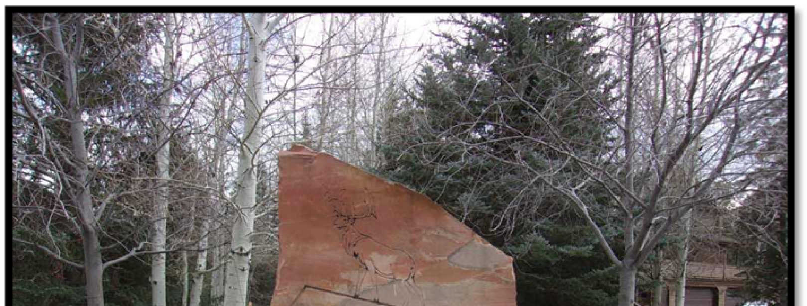
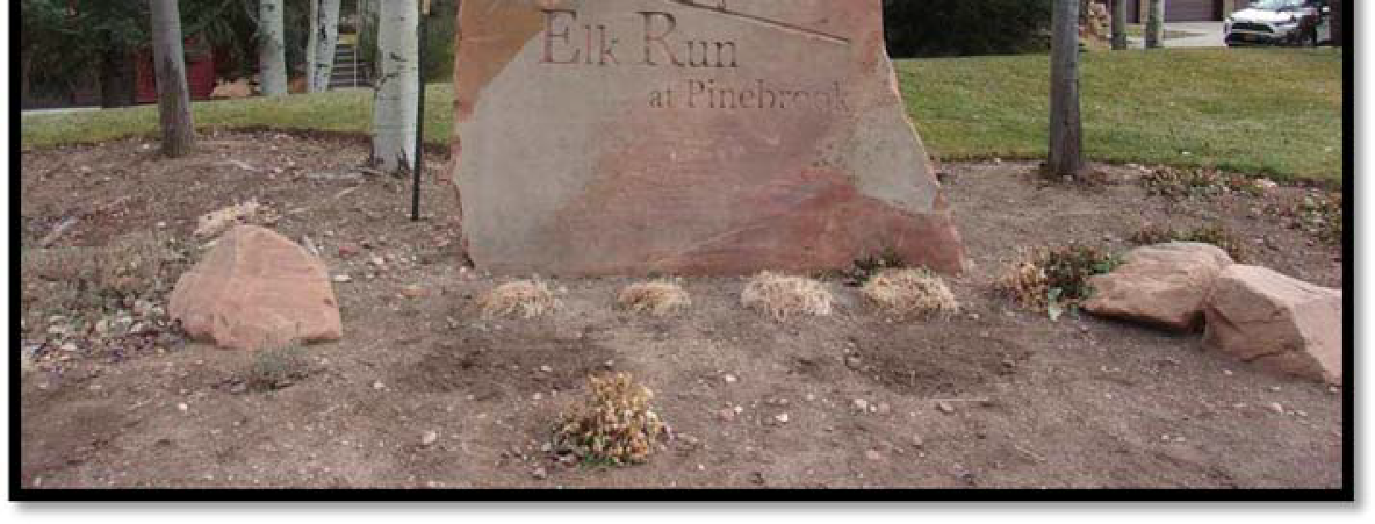
Elk Run at Pinebrook - Phase IV
Level 2 Reserve Study
Report Period – 01/01/2021 – 12/31/2021
Client Reference Number 12761
Property Type Townhouse
Number of Units 40
Fiscal Year End 12/31
Type of Study Update w/Site Visit
Date of Property Inspection 11/6/2020
Prepared By Dale Gifford
Analysis Method Cash Flow
Funding Goal Full Funding
Report prepared on – Monday, December 14, 2021
TEL: (888) 356-3783 | Fax: (866) 279-9662
WWW.COMPLEXSOLUTIONSLTD.Com
Draft

Slide 13
Reserve Study Recommended Funding

Slide 14
Reserve Accounts
Roofing Reserve (Acct 3903)
Starting Balance $76,769.31
Current Balance (June 1st)J $67,662.88
Insurance Deductible Reserve (Acct 3911)
Starting Balance $0
Current Balance $30,663.72
General Maintenance Reserve (Acct 3938)
Starting Balance $0
Current Balance $17,519.14
Concrete/Drive Reserve (Acct 3946)
Starting Balance $135,265.75
Current Balance $135,502.01
Buildings/Paint Reserve (Acc 3954)
Starting Balance $122,103.41
Current Balance $113,951.00
Total Reserves
Starting Balance $334,138.47
Current Balance $365,298.75

Slide 15
Operating Cash Account
Operating (Acct 0520)
12-31-2022 Starting Balance $87,887.16
Resets at start of each year at $45,000
All excess funds are distributed into Reserve accounts
5-31 Current balance is $37,120.00
$57,021.33 ???????

Slide 16
2023 Planned 5 Year Budget
 |  | 2021 |  | 2022 |  | 2023 |  | 2024 |  | 2025 |  | 2026 |  | 2027
 |  | 3% YOY |  | 3% YOY |  | 3% YOY |  | 3% YOY |  | 3% YOY |  | 3% YOY |  | 3% YOY
INCOME
Assessments |  | $172,000 |  | $184,000 |  | $184,000 |  | $184,000 |  | $184,000 |  | $184,000 |  | $184,000
No Proxy Fee |  | $309 |  | $318 |  | $328 |  | $338 |  | $348 |  | $358 |  | $369
Interest |  | $5 |  | $5 |  | $5 |  | $6 |  | $6 |  | $6 |  | $6
Late Fees |  | $651 |  | $670 |  | $691 |  | $711 |  | $755 |  | $755 |  | $777
Reinvestment Fees |  | $361 |  | $371 |  | $382 |  | $394 |  | $418 |  | $418 |  | $430
Collection Fees |  | $26 |  | $27 |  | $27 |  | $28 |  | $30 |  | $30 |  | $31
TOTAL INCOME |  | $173,351 |  | $185,392 |  | $185,434 |  | $185,477 |  | $185,556 |  | $185,567 |  | $185,614
OPERATING EXPENSES
Fees |  | $176 |  | $181 |  | $187 |  | $192 |  | $204 |  | $210 |  | $217
Copies&Postage |  | $158 |  | $162 |  | $167 |  | $172 |  | $183 |  | $188 |  | $194
Prof.Service |  | $1,154 |  | $1,188 |  | $1,224 |  | $1,261 |  | $1,337 |  | $1,377 |  | $1,419
Board Services |  | $10,702 |  | $11,023 |  | $11,353 |  | $11,694 |  | $12,406 |  | $12,778 |  | $13,162
Taxes |  | $177 |  | $182 |  | $188 |  | $194 |  | $205 |  | $212 |  | $218
Gen. Operating |  | $114 |  | $118 |  | $121 |  | $125 |  | $133 |  | $137 |  | $141
Insur. Master Policy |  | $15,925 |  | $16,403 |  | $16,895 |  | $17,402 |  | $17,924 |  | $19,015 |  | $19,586
Insur. D&O |  | $1,484 |  | $1,529 |  | $1,575 |  | $1,622 |  | $1,721 |  | $1,772 |  | $1,825
Legal |  | $1,530 |  | $1,575 |  | $1,623 |  | $1,671 |  | $1,773 |  | $1,826 |  | $1,881
Accounting |  | $5,459 |  | $5,623 |  | $5,791 |  | $5,965 |  | $6,328 |  | $6,518 |  | $6,714
Maint. & Repairs |  | $808 |  | $832 |  | $857 |  | $882 |  | $936 |  | $964 |  | $993
Fire Sprinklers |  | $2,988 |  | $3,078 |  | $3,170 |  | $3,265 |  | $3,464 |  | $3,568 |  | $3,675
Landscaping Cont. |  | $55,000 |  | $58,350 |  | $38,350 |  | $39,501 |  | $40,686 |  | $41,906 |  | $43,163
Landscaping Sprinklers |  | $1,167 |  | $1,202 |  | $1,238 |  | $1,275 |  | $1,353 |  | $1,393 |  | $1,435
Tree Spray |  | $874 |  | $901 |  | $928 |  | $956 |  | $1,014 |  | $1,044 |  | $1,075
Landscaping Fert. |  | $1,140 |  | $1,174 |  | $1,210 |  | $1,246 |  | $1,322 |  | $1,361 |  | $1,402
Snow Removal Contract* |  |  |  |  |  | $21,750 |  | $22,403 |  | $23,075 |  | $23,767 |  | $24,480
Snow Removal Extra |  | $4,820 |  | $4,965 |  | $5,114 |  | $5,267 |  | $5,588 |  | $5,756 |  | $5,928
Electricity |  | $159 |  | $163 |  | $168 |  | $173 |  | $184 |  | $189 |  | $195
Water |  | $6,269 |  | $6,457 |  | $6,650 |  | $6,850 |  | $7,267 |  | $7,485 |  | $7,710
TOTAL EXPENSE |  | $110,103 |  | $115,106 |  | $118,559 |  | $122,116 |  | $127,102 |  | $131,469 |  | $135,413
NET OPERATING INCOME |  | $63,248 |  | $70,286 |  | $66,875 |  | $63,361 |  | $58,454 |  | $54,098 |  | $50,201

Slide 17
Key Take-aways from Finances
Dues Increase in 2021 helped to allowed handling of increased expenses
Budget Forecasts are not set in stone
Snow removal was double original budgets
Landscaping may help recover on that a bit.
Reserves remain strong and are in great shape
Vigilance will continue to be warranted and necessary

Slide 18
Building Maintenance and Issues

Slide 19
Building Maintenance and Painting
Siding and Trim Maintenance, Touch-Up/Repair Only
No Full Building Painting this year
Maintenance List has been sent to all homeowners
Please respond by via e-mail by July 1, 2023 if there are any discrepancies
Last 2 weeks of July through first 2 weeks of August
Will evaluate in Spring 2024 if a building requires full painting.

Slide 20
Building Maintenance and Painting
Vents at unit entryway (through roof) will be inspected this summer
Not all units have this condition
Repair if needed
Roofs will be inspected this summer as well to evaluate condition and any potential repair.
Overall Building Maintenance Schedule/Program is being evaluated this year
Siding Paint & Repair Cycle
Full Paint Cycle
Concrete Repair/Replacement Cycle
Roofing Repair/Replacement Cycle

Slide 21
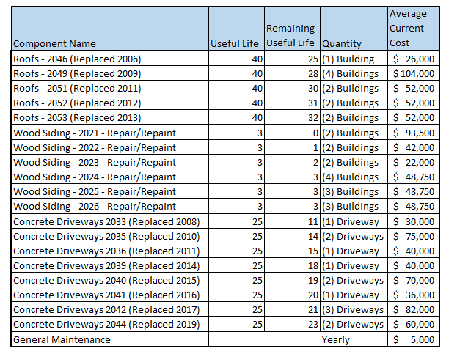
Building Maintenance and Painting Future Capital Expenditures

Slide 22
Fire Suppression
2022-2023 Accomplishments:
Thank you all for your patience and accomodation
7.25 Buildings Completed (29 Units)
2023 Remaining Plan
FECI unforseen departure from project
In process of hiring new Fire Suppression Contractor
Expected to see pricing and availability by July 7, 2023
3.5 Units remain for fire sprinkler head replacement
7 Units remain for attic pipe replacement
9 Riser room updates and inspections
Target Completion: Labor Day (OR SOONER)

Slide 23
Landscaping and Snow Removal
Barrios Landscaping – Benito Barrios
Beautification Projects
Mulching
Tree trimming
Last season’s Snow Removal - discussion
Plans for Snow Removal
Likely Barrios
Homeowners Input

Slide 24
Community Garden
Update on plans:
Committee members
Timeframes
Costs
Location
Obligations
Opportunity

Slide 25
Other subjects and interests
Other Subjects for discussion
How do we want to do registration for the Annual Meeting
What are the Proxy and Voting rules and guidelines
Do we allow for Zoom attendance and Zoom-based voting (doing so now)
Do we need more Internet or Zoom – based communications / meetings
Other Subjects
Tennis Court Parcel

Slide 26
THANK YOU FOR COMING

